Slide 1
Project Seminar 5 LSEPI
Dr Alex Lohfink

Slide 2
Approximately 5 pages (dissertation)
1 page (interim report)
Chapter in Interim Report
Appendix in dissertation
Used to introduce the general background to projects and where LSEPI might fit in
Then take this and apply in detail to your own particular project study
LSEPI - Legal Social Ethical and Professional Issues
2

Slide 3
What legal questions should you be asking:
Licenses for software
If developing software or guidelines that will be used by a company - crashes/fails/ misleads - degree of personal responsibility?
Who owns the project deliverable?
Does your supervisor have any claim to any fee that you charge for your deliverable’s use?
Legal Aspects
3

Slide 4
Use individual’s comments from interviews / sources
e.g. off Facebook?
Anonymity of user input
Access to an appropriate user group
Trust
Photos taken of individuals and included in your report or system
Who owns the feedback - are you liable for reporting possible negative comments about a company, etc
Personally investigating sensitive areas - e.g. dark web, paedophilia, …..
Social Aspects

Slide 5
What are ethics?
What is ethical approval - form to be included
Is it the same as morals?
Ethical
5

Slide 6
Remove bias
Professional Integrity - whatever that is?
Ethical to others you are working with and ‘using’
Whilst researching must manage politics, power, ethics and prejudice
Credible Research - “…reliability, validity, authenticity, neutrality and auditability.”
Aim for ‘pure objectivity’ - therefore require strict and attainable protocols.
Ethical Practices in Research (O’Leary, 2014)

Slide 7
Please get out a piece of paper and pen
I will now read out the exam questions and their solutions
I have been threatened that I will lose my job if the exam results in this module do not improve
Please don’t tell anyone that I’m doing this
Is this Ethical?
Exam questions exampe

Slide 8
I needed money for my family
I worked for a company that developed software for gaming machines
A company approached me and asked me to modify the code of one of the machines that they had purchased from my company
I refused as it would mean that I would have used my access to the source code to do the changes
The company offered to pay me to develop a dis-assembler program and then to modify the code based upon ‘this source’
IF I did it - then were my actions morally and/or ethically correct??
Is this ethical?

Slide 9
Ethical Practices in Research (O’Leary, 2014)
Research can become ‘dichotomized - e.g. male/female, black/white, …. Must recognise overlapping groups.
Essential to guard against assumptions and biases based upon society –
e.g. write a sentence that sums up your expectations of life/people from a valley in South Wales.
Now write a sentence that sums up your expectations of life/people in a ‘leafy’ village in the South East of England.

Slide 10
Ethical Practices in Research (O’Leary, 2014)
Ethical Responsibility as a Researcher
Legal Obligations
comply with the law in your research methods
what to do if your research identifies illegal activity - as a researcher can you provide assurances of confidentiality (like a doctor)
Moral Obligations
rights and wrongs
honesty - collect data for a particular reason and not re-use for a different purpose

Slide 11
Ethical Obligations of you as a Researcher
Ensuring Respondents have given informed consent, they are competent, autonomous, voluntary, not deceived
Ensuring no harm comes to respondents
Ensuring confidentiality - or respondents understand limitations

Slide 12
Ethics at the University
Research at the University of South Wales
Ethical Principles and Guidelines for Research
The University has set up a two tier structure for ethical issues with responsibility shared between the University Ethics Sub Group (UESG) - a committee of Quality Assurance Committee - and a Faculty Research Programmes Committee (FRPC) which will consider all research proposals.
Further information is available from the Research Office: here
General Ethical Concerns
Ethics is a complex subject, but in professional contexts its four central concerns are:
to treat people Fairly
to respect the Autonomy of individuals to act with Integrity
to seek the best Results - by avoiding or minimising harm and by using resources as beneficially as possible
Mnemonic: f a i r

Slide 13
Morals (Collins dictionary)
Concerned with human behaviour, especially the distinction between good and bad or right and wrong behaviour.
Adhering to conventionally accepted standards of conduct. Based on a sense of right and wrong according to conscience.
Ethics (Collins dictionary)
The philosophical study of the moral value of human conduct and of the rules and principles that ought to govern it. A code of behaviour considered correct, especially that of a particular group, profession or individual.
Morality v Ethics

Slide 14
MORALS | ETHICS
Personal Rules of Conduct | Philosophical Reflection/Study on Morality
What people ought and ought not do in various situations | Search to justify the morality in a Social system
Defines Personal character | Rational examination into people’s moral beliefs and behaviours
An MP votes for a bill in parliament that will give him a 15% pay rise - yet his/her constituents are the poorest in the country
A lawyer may well find an individual offensive, arrogant and even know that he/she is guilty of a crime (morally he dislikes him) yet the lawyer ethically must do everything to defend the individual.
Ethics overrides personal morals?

Slide 15
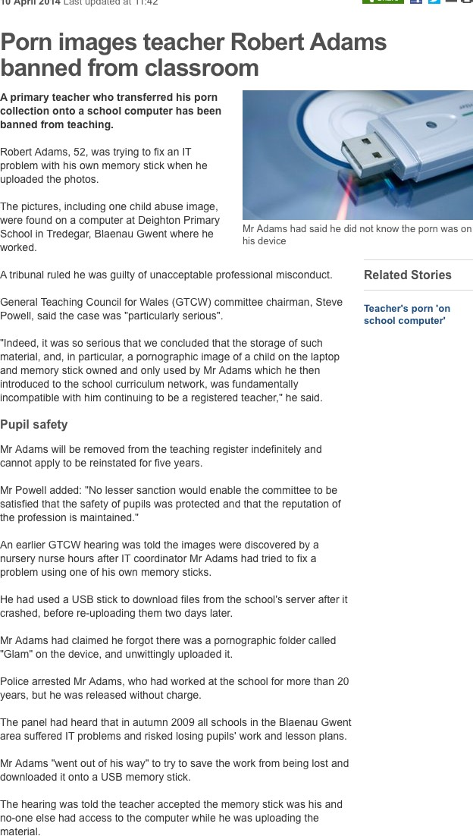
Porn images teacher Robert Adams banned from classroom
BBC News 10th April, 2014
http:// www.bbc.c o.uk/news/ uk-wales- south- east- wales-269 63034
Why was he sacked?

Slide 16
An occupation requiring special training in the liberal arts or sciences, especially now of the three learned professions of law, theology or medicine. (Collins dictionary)
There are now ‘many’ occupations that are considered ‘professional’ - they require particular standards and initial/ ongoing education.
“A profession is a vocation that requires a high level of education and practical experience in the field” (Quinn, 2005)
Consider some jobs - are they professional or not?
A Profession

Slide 17
Mastery of an Esoteric Body of Knowledge
Autonomy
Formal organisations
Code(s) of ethics
A Culture of Practice
The FIVE characteristics of a Profession (Johnson, 2009)

Slide 18
Mastery of an Esoteric Body of Knowledge
In a strongly diﬀerentiated profession there is an associated esoteric body of knowledge
esoteric = obscure, known by only a few
This knowledge can only be mastered through disciplined study – typically via higher education
Knowledge is unlikely to be acquired simply through hands-on experience
There is usually a core body of knowledge known to all within the profession
Because this body of knowledge is so important, professions often have both
Researchers
Practitioners

Slide 19
Autonomy
Members of professions typically have a good deal of autonomy in their work compared to other occupations in which members simply act on orders given
e.g. a doctor decides treatment for patient, a lawyer decides best defence
strategy for client,….
Strongly diﬀerentiated professions also have collective autonomy (self regulation)
admission standards
educational requirements
standards of practice
In strongly diﬀerentiated professions, members are allowed to do what others cannot
e.g. Doctors can prescribe drugs, police oﬃcers can use force, …

Slide 20

Strongly diﬀerentiated professions usually have a professional organisation recognised by state government that controls admission to the profession and sets standards for practice.
For example, in UK
the General Medical Council (which protects, promotes and maintains the health and safety of the public by ensuring proper standards in the practice of medicine)
the Bar Standards Board (regulates barristers in England and Wales in the public interest) and the Bar Council (promotes...highest standards of ethics....)
Formal Organisations

Slide 21
Codes of Ethics
Set standards
Tell clients, employers and the public what to expect Contributes to creation of a professional culture
Formal way of stating that the profession is committed to achieving or protecting certain social values
Codes of ethics may be diﬃcult to enforce - ‘Struck Oﬀ’
Examples
Engineering Council (http://www.engc.org.uk/professional- ethics.aspx)
Royal Institution of Chartered Surveyors (http://www.rics.org/ uk/the-profession/professional-and-ethical-standards/our-ﬁve- professional-and-ethical-standards)
Code of Ethics of Professional Conduct

Slide 22
For most professions there is a distinctive culture associated with practices in the ﬁeld
Strongly diﬀerentiated professions fulﬁl an important social function or are committed to a social good
Culture of professions sometimes leads to satirical attack
Doctors arrogant and aloof
Lawyers scheming and dishonest
Engineers socially inept
Culture of Practice

Slide 23
Mastery of Esoteric Knowledge
Autonomy
Organisations
Codes
Culture
How does Lecturing measure up against Johnson’s 5 characteristics?
How does being a Member of Parliament measure up against Johnson’s 5 characteristics?
How does Computing measure up against
Johnson’s 5 characteristics?

Slide 24
What is Plagiarism?
Have you ever intentionally plagiarised
Have you ever realised post-submission that you have plagiarised
Are you aware of the University’s Plagiarism guidelines?
Plagiarism
24

Slide 25
References
ACM (1992) “ACM Code of Ethics and Professional Conduct”, http://www.acm.org/about/code-of- ethics
Johnson, D.G. (2009) Computer Ethics (4th Edition) New Jersey: Pearson Education BCS (2004) “BCS Code of Practice”, http://www.bcs.org/category/6031
BCS (2006) “BCS Code of Conduct”, http://www.bcs.org/category/6030
IEEE (2006) “IEEE Code of Ethics”, http://www.ieee.org/about/ethics_code/ DF_IEEE_MIG_MCT_80596
O’Leary, Z (2014) “The Essential guide to Doing Your Research Project 2nd Edition, Sage Publications.

